Slide 1
DL-CFAR: A Novel CFAR Target Detection Method Based on Deep Learning
C. -H. Lin, Y. -C. Lin, Y. Bai, W. -H. Chung, T. -S. Lee and H. Huttunen, “DL-CFAR: A Novel CFAR Target Detection Method Based on Deep Learning,” 2019 IEEE 90th Vehicular Technology Conference (VTC 2019-Fall), 2019, p.1-6. (cited by 10)
Advisor: Dr. Chih-Yu Wang
Presenter: Shao-Heng Chen
Date: May 18, 2022
Notes:
2019年6月發表於 IEEE VTC 會議的論文

Slide 2
Outline
1. Overview
2. System model
3. DL-CFAR
4. Simulation results
5. Future works
1

Slide 3
Overview
1. Objective
– Improve noise level estimation through DL-based scheme
2. Difficulties
– Multi-target scenarios
– Side-lobe issues
– High computational complexity
2
Notes:
CFAR演算法目標是估計noise level 不是直接估target
舊有的CFAR演算法困難點有 multi-target scenarios 效果不好, computational complexity太高,
side-lobe問題 strong side-lobes 和相應的 target returns 使得 noise levels會被高估, 使得detection rates較低

Slide 4
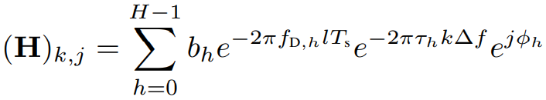
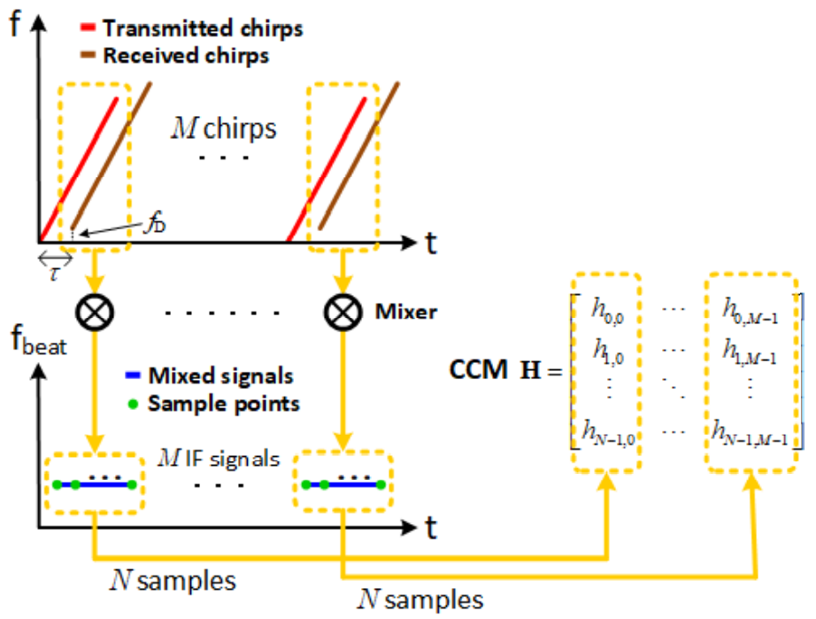
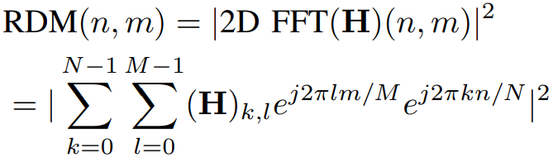
System model
– Target detection with FMCW (Frequency-Modulated Continuous-Wave) Radar
– Target information (range, Doppler velocity) derived from CCM (Channel Coeff.)
3
Notes:
Target detection 利用 FMCW radar 打波訊號並收回波訊號 去推得 target information (包含 range, Doppler velocity)
要用 time-frequency channel coefficients 去推得 target information, H 是 channel coefficient matrix (CCM) 由 H個 目標回波組成, 下標k是指第k個freq., 下標l是指第l個time sample 第l個時間點的取樣
Ts 是取樣週期, ∆f 是頻率間隔 freq. spacing, bh 是 complex amplitude, fDh 是 Doppler shift, τh 是 RTT(round-trip time), φh 是 隨機相位旋轉, 下標h是指第h個目標回波
由CCM H經過2D FFT可以得到RD Map, RD Map由 N x M 個 RD bin組成, N為freq.的FFT length, M為time的FFT length

Slide 5
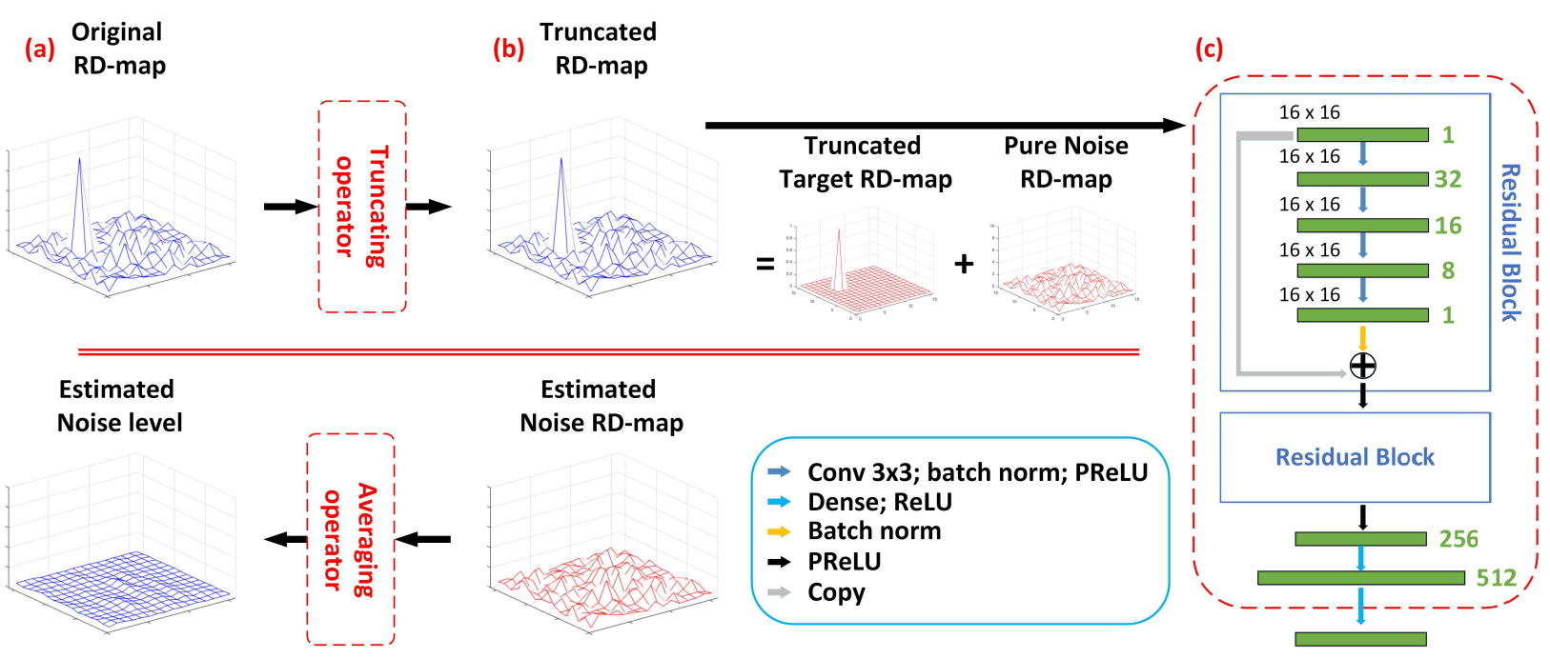
DL-CFAR
– Recognize and remove target patterns from RDM to improve noise level estimations
4

Slide 6

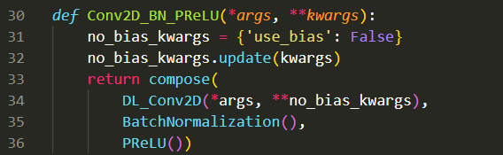
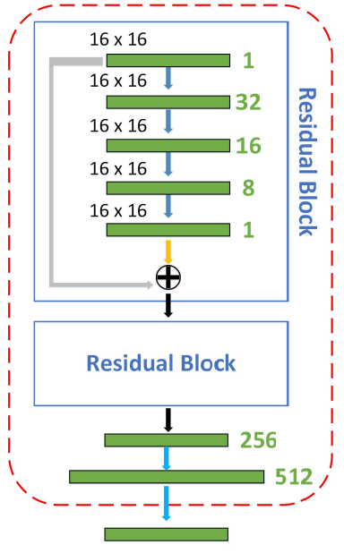
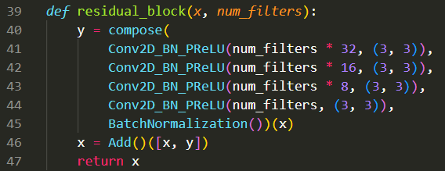
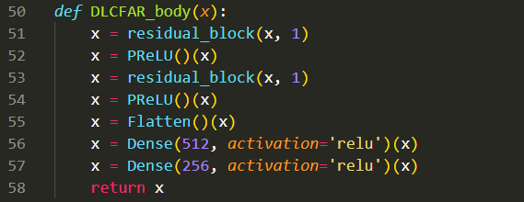
DL-CFAR Architecture
– Original size: 16 kB
– Total: 305,312 – Trainable: 305,080
– Non-trainable: 232
– No pooling to kept
all information
5
Notes:
DL_CFAR 只有 16kB左右 但keras library有16MB左右

Slide 7
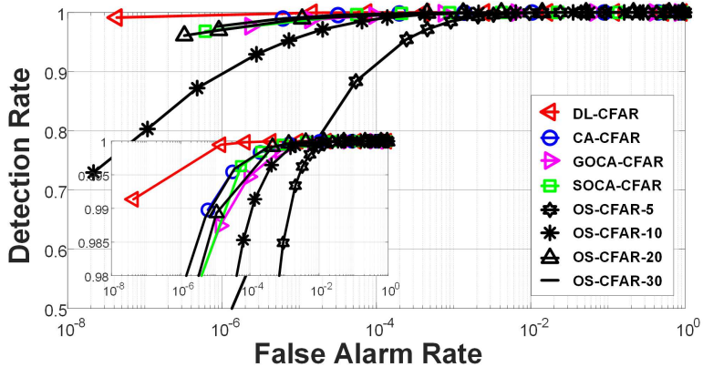
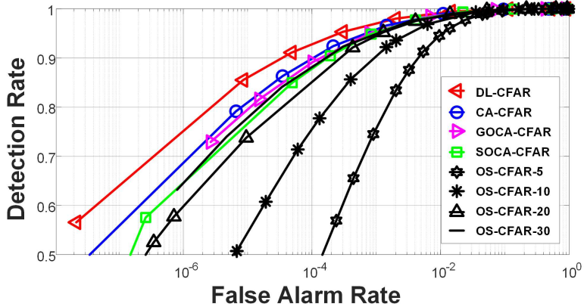
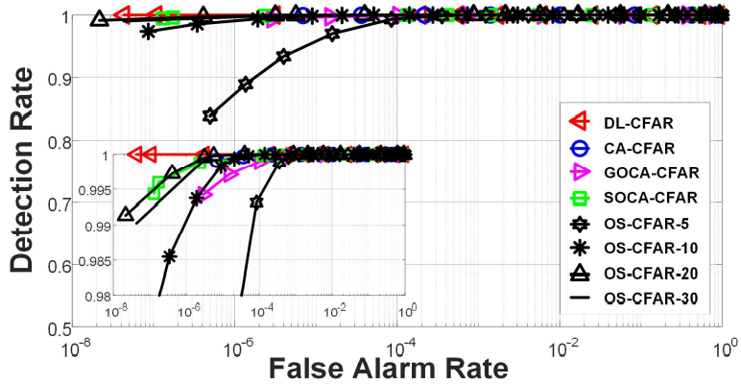
Simulation results
– Trade-off between detection rates and
false alarm rates
– Single target with different SNR
7
Notes:
希望當 false alarm rate 足夠低時 對應的 detection rate 掉的越低越好
CA-CFAR (Cell Average CFAR), GOCA-CFAR (Greatest Of CA-CFAR) multi-target效果不好
SOCA-CFAR (Smallest Of CA-CFAR) 高密度的multi-target效果不好
OS-CFAR (Order Statistic CFAR) 計算複雜度太高 比NN還高

Slide 8
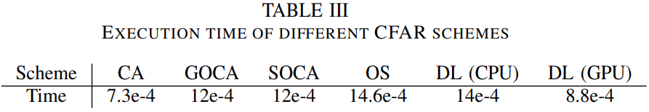
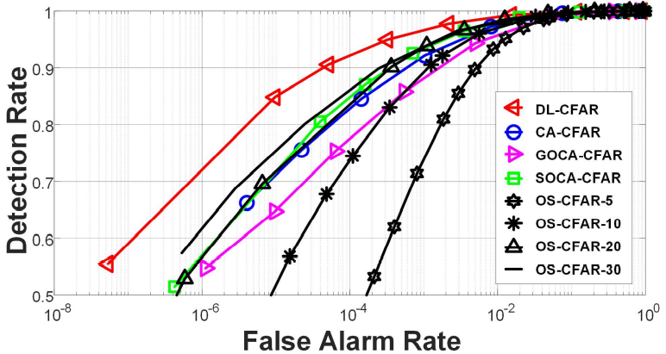
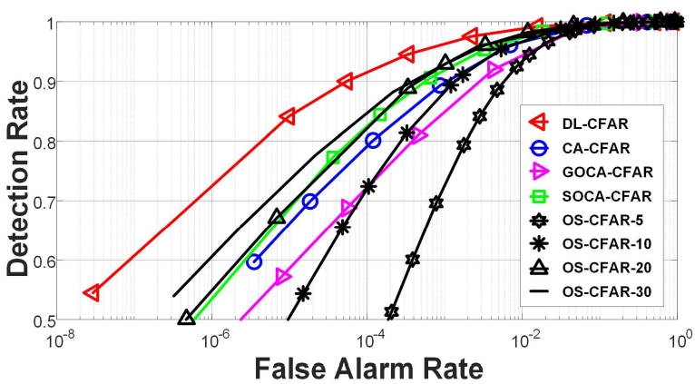
Simulation results
– Multi-target of 3 and 4 with low SNR
– Execution times comparison
8
Notes:
希望當 false alarm rate 足夠低時 對應的 detection rate 掉的越低越好
CA-CFAR (Cell Average CFAR), GOCA-CFAR (Greatest Of CA-CFAR) multi-target效果不好
SOCA-CFAR (Smallest Of CA-CFAR) 高密度的multi-target效果不好
OS-CFAR (Order Statistic CFAR) 計算複雜度太高 比NN還高

Slide 9
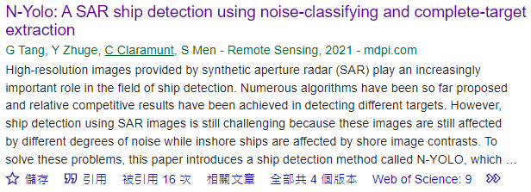
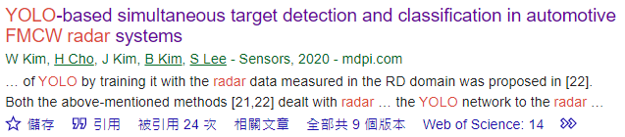
Future Works
– DL-CFAR is quite small (ResNet18 45MB, squeezeNet 5MB, MobileNet 17MB)
8

